Slide 1
Topic: Ratios EQ: How to use ratios to solve real world scenarios?
Year 11 Essentials

Slide 2
Things Required For This Lesson
Interactive Notebook
Textbook: Interleaved Maths Essential Connections
Ruler, Red Pen, Pencil, Pens, Scientific Calculator
Growth mindset

Slide 3

24
7
30
Topic: Ratios
Date: /03/2021
EQ: How to use ratios to solve real world scenarios?
WICOR
This Photo by Unknown Author is licensed under CC BY-SA

Slide 4
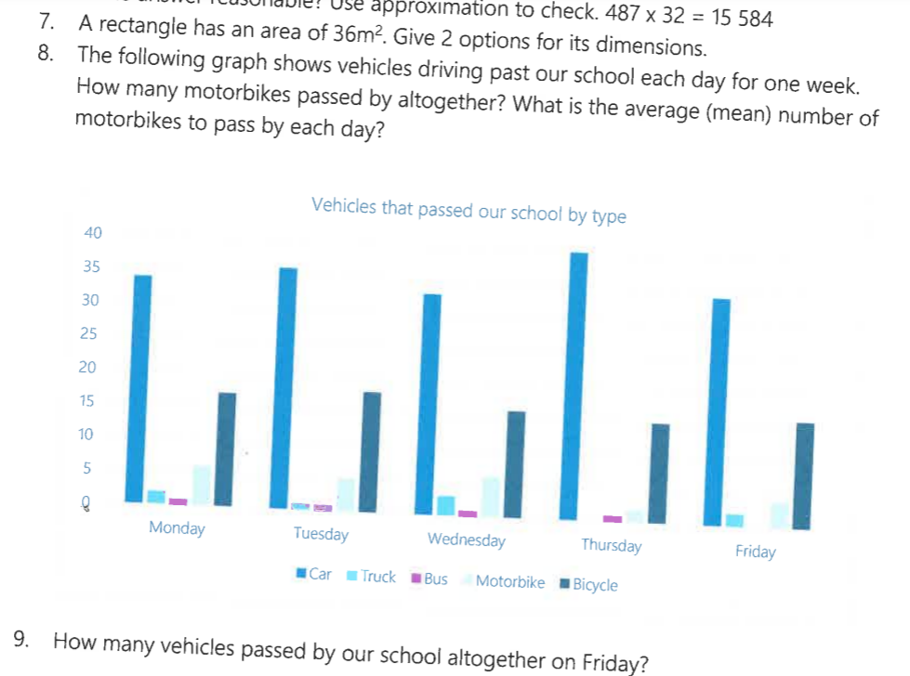
Topic: Ratios
EQ: How to use ratios to solve real world scenarios?

Slide 5
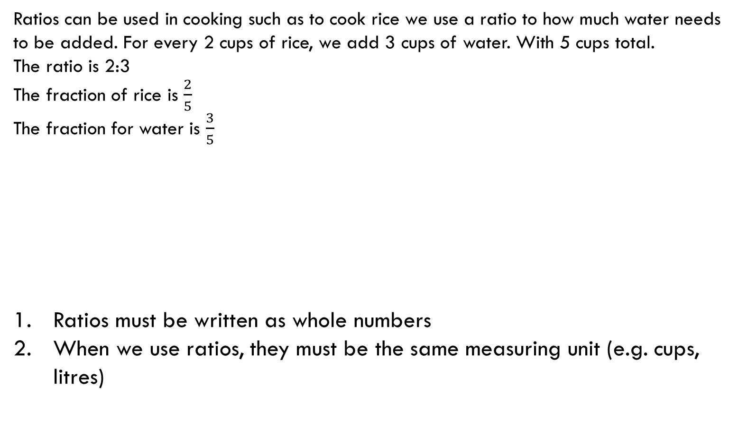
24
7
30
Topic: Ratios
EQ: How to use ratios to solve real world scenarios?
How to write ratios
Key rules for ratios
Ratios can be used in cooking such as to cook rice we use a ratio to how much water needs to be added. For every 2 cups of rice, we add 3 cups of water. With 5 cups total.
The ratio is 2:3
The fraction of rice is $\frac{2}{5}$
The fraction for water is $\frac{3}{5}$
Ratios must be written as whole numbers
When we use ratios, they must be the same measuring unit (e.g. cups, litres)
Whole: 5 parts
Rice: 2 parts |  | Water: 3 parts
WICOR

Slide 6



Think pair share
Discuss similarities and differences between ratios and fractions.
Using the previous example. What might you need to change if you needed 4 cups of rice?
Original ratio $2 :3$
$4 :$ 6
$$2×$$
$$×2$$
Notes:
Discuss partitioning strategy – breaking up a rectangle into parts shows that the discount is 5 out of 50 which calculates to a 10% discount

Slide 7
Practice: (LHS)
Recipe for playdough
2 cups plain flour
1 cup salt
25mL oil
1 cup cold water
Food colouring if desired
Mix flour and salt. Add wet ingredients. Knead until combined
Examine the recipe for playdough. You need to know that 1 cup holds 250mL
Work out a ratios for the ingredients using the same base measurement
Adjust your ratio so that the oil is 1. How do your other ingredients change?
Notes:
Convert the oil to a cup by multiplying by 10

Slide 8
Practice: Complete questions on pages 30 and 31

Slide 9

Exit Pass
1. Can I have 1:1$\frac{1}{2}$ cups as a measurement? If not, what do you need to do to the ratio?
2. What are the 2 key points to remember when using ratios?

Slide 10

Thank you
Keep up the good work!
“Success is to be measured not so much by the position that one has reached in life as by the obstacles which he has overcome.”
- Booker T. Washington

